Slide 1
Manish Patel
Auto Insurance Fraud Detection
Data Science Intensive Capstone Project, August 2023 Cohort

Slide 2
Problem Identification
We are analyzing a database from an American insurance company to address vehicle insurance fraud. This type of fraud typically involves fraudulent claims that overstate property damage or personal injuries resulting from vehicular accidents. Our primary goal is to develop a reliable method for distinguishing between fraudulent and logical insurance claims.
Auto insurance fraud poses a significant challenge within the industry, necessitating robust detection and prevention measures to uphold integrity and ensure equitable treatment for all policyholders. In 2020, it was estimated that approximately 8,898 vehicles in the United States. These fraudulent activities, including various car insurance scams, inflict substantial financial harm on insurers, with annual losses estimated at around $29 billion. This not only undermines the financial stability of insurance companies but also inflates premiums for honest customers, highlighting the critical need for effective countermeasures.

Slide 3
Data Information
Data acquisition https://www.kaggle.com/datasets/shivamb/vehicle-claim-fraud-detection
No of Records : 15420
No of fields : 33
Data Acquired for the Period : 1994-1996

Slide 4
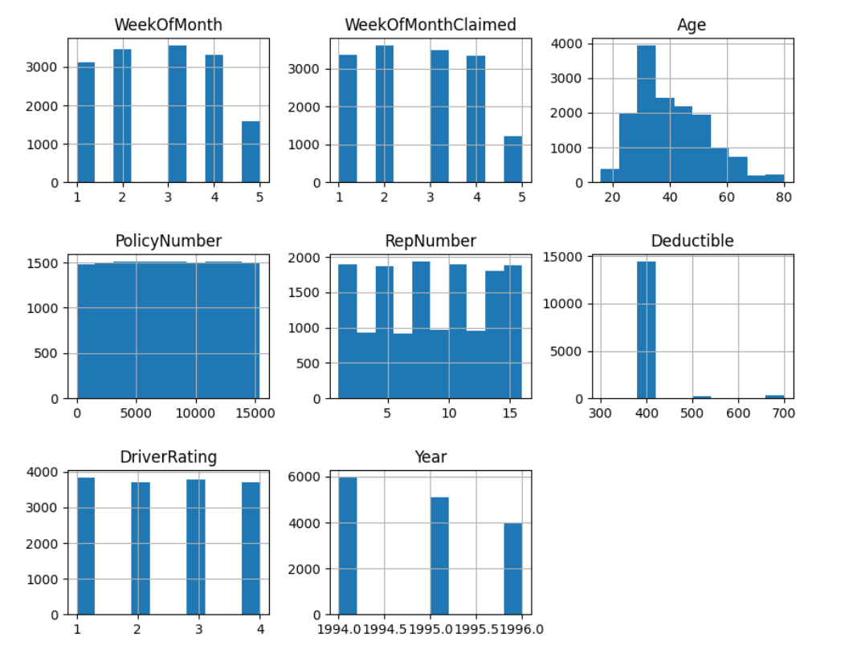
Distributions Of Feature Values

Slide 5
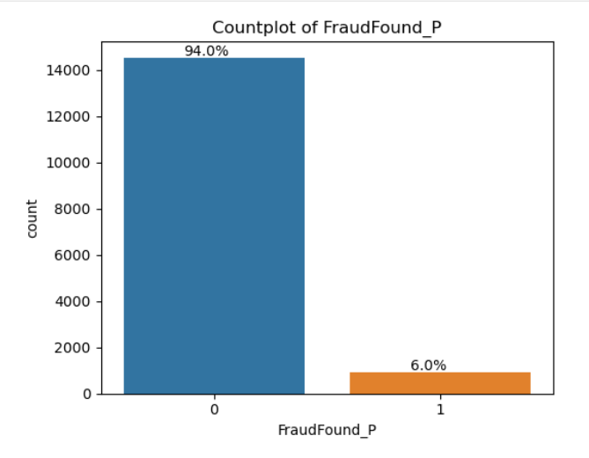
Fraud found in dataset
A total of 15420 records were found. Out of those, 883 cases of fraud were detected.

Slide 6
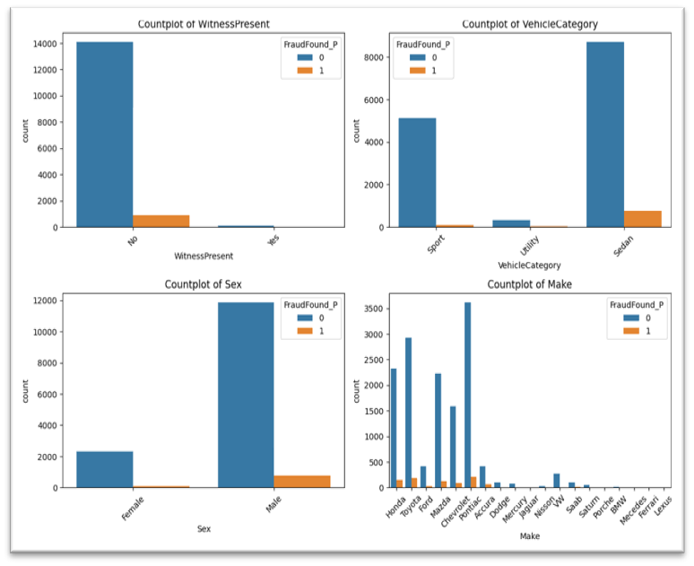
Count plot
- The WitnessPresent graph indicates that in most claims, witnesses were not present.
- In the VehicleCategory plot, it is evident that sedan is the category with the highest number of fraudulent claims.
- Regarding Sex, the graph shows that men make up the majority of the claimants and that men who make false claims are more common.
- Lastly, among 19 car brands, it is observed that only 5 of them have more claims while the others have negligible claims.

Slide 7
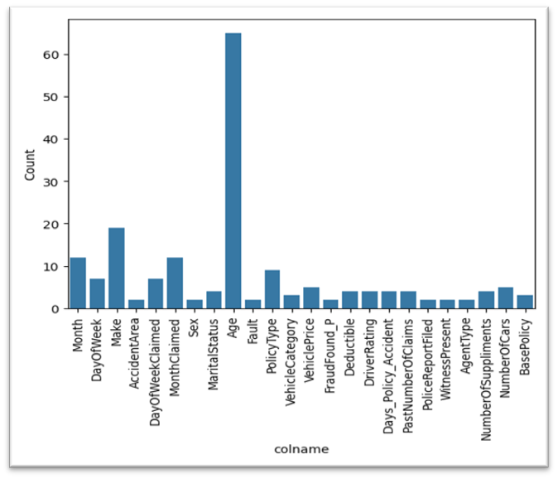
Effectively showcases how each feature holds a unique and valuable contribution.

Slide 8
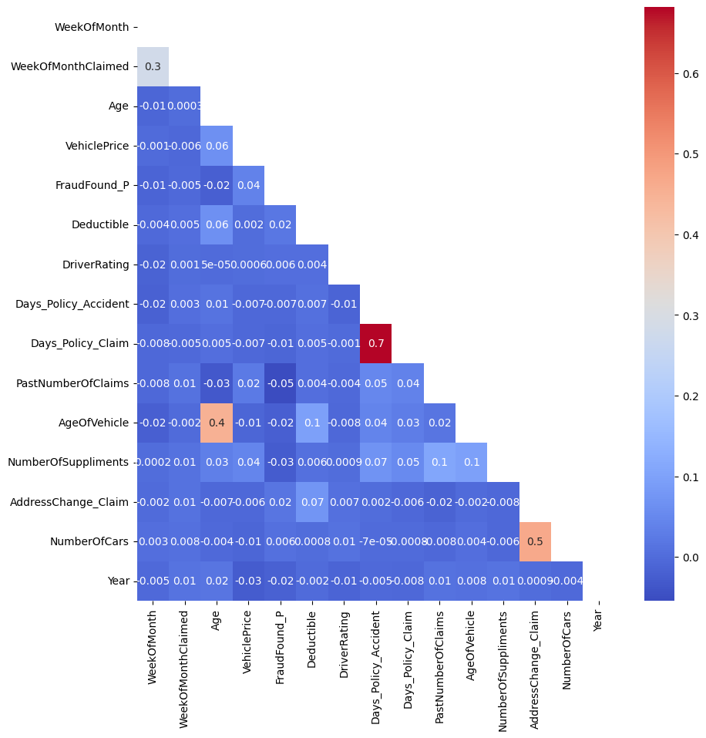
A heatmap to identify correlated features and minimize redundancy in our data selection process.
.

Slide 9
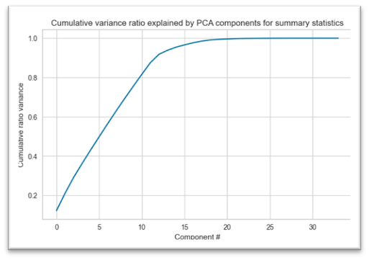
Feature reduction (PCA)
First thirteen components seem to account for over 95% of the variance.

Slide 10
Predictive Modeling
Modeling Overview
Type : Supervised Learning
Binary classification: 1 for cancelled and 0 for non-cancelled flights.
Highly imbalanced data: 6% data tagged with class 1.[Needs special attention]
Tools: Python’s scikit learn and imblearn.

Slide 11
Getting the best of each classifier
Data preprocessing, preparation and selection
One-hot-encoding of all categorical variables.
Standard scaling of all numerical variables.
Select 13 essential components that will make it truly remarkable.
Resampling to take care of imbalanced problem.
Split the data into training (80%) and test (25%) datasets.

Slide 12
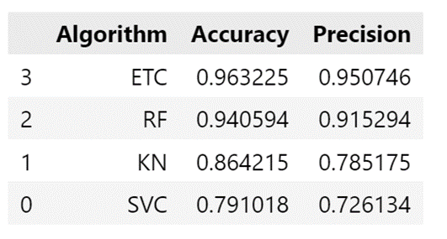
Comparing the best of each classifier
Model Selection
o Extra trees classifier(ETC)
o RandomForest (RF)
o k-nearest neighbors (KNN)
o support vector machine (SVM)

Slide 13
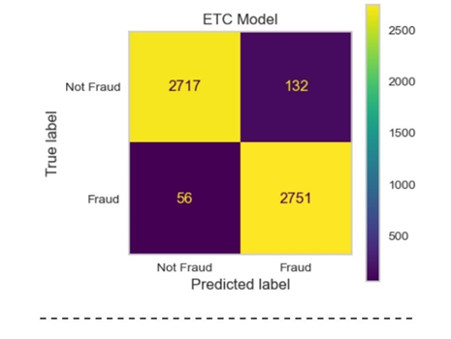
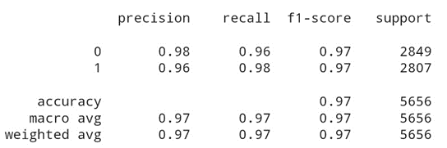
Best Model
Pick the set of hyper parameters and the model that provide highest Accuracy and Precision
The Extra Trees Classifier not only achieved the highest accuracy score compared to its counterparts but also demonstrated exceptional performance in recall. Recall, or the true positive rate, is particularly crucial in the context of fraud detection as it measures the model’s ability to correctly identify all actual fraud cases. A higher recall indicates fewer false negatives, meaning fewer instances of fraud go undetected.

Slide 14
Thank you
Manish
Email:-pmanish790@yahoo.in

